Slide 1
A multi-agent FLISR model for inverter-dominated smart grids

Slide 2
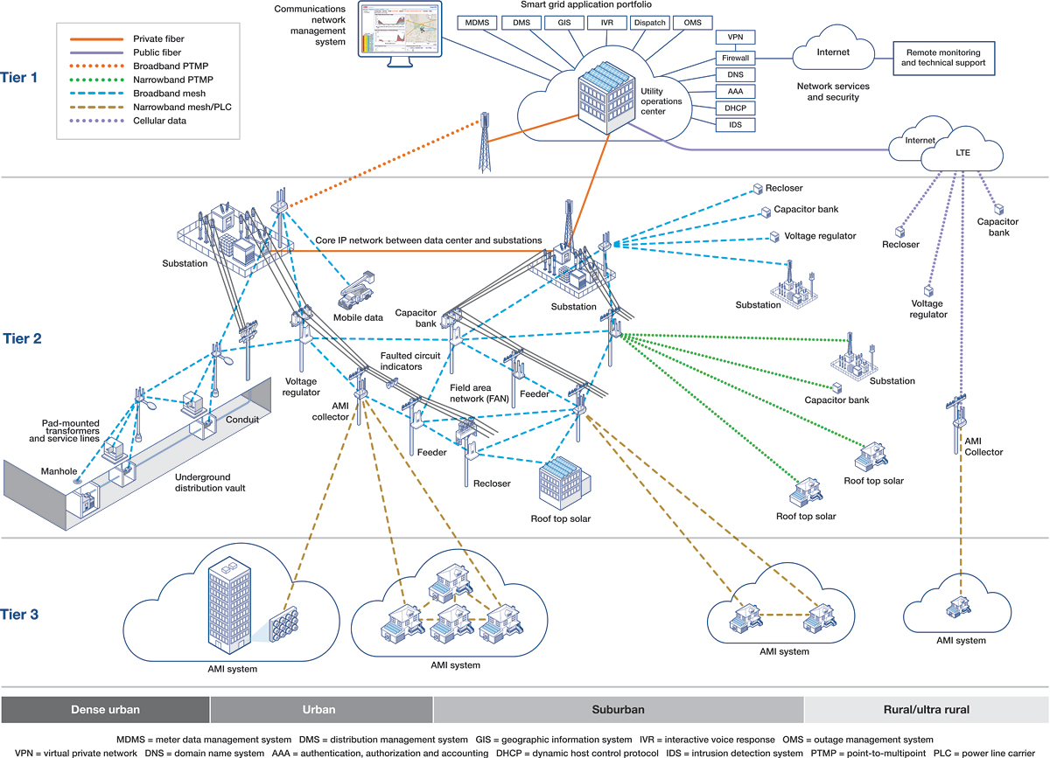
Three Tier Electrical Power System
Wide Area Network
Field Area Network
Home Area Network

Slide 3
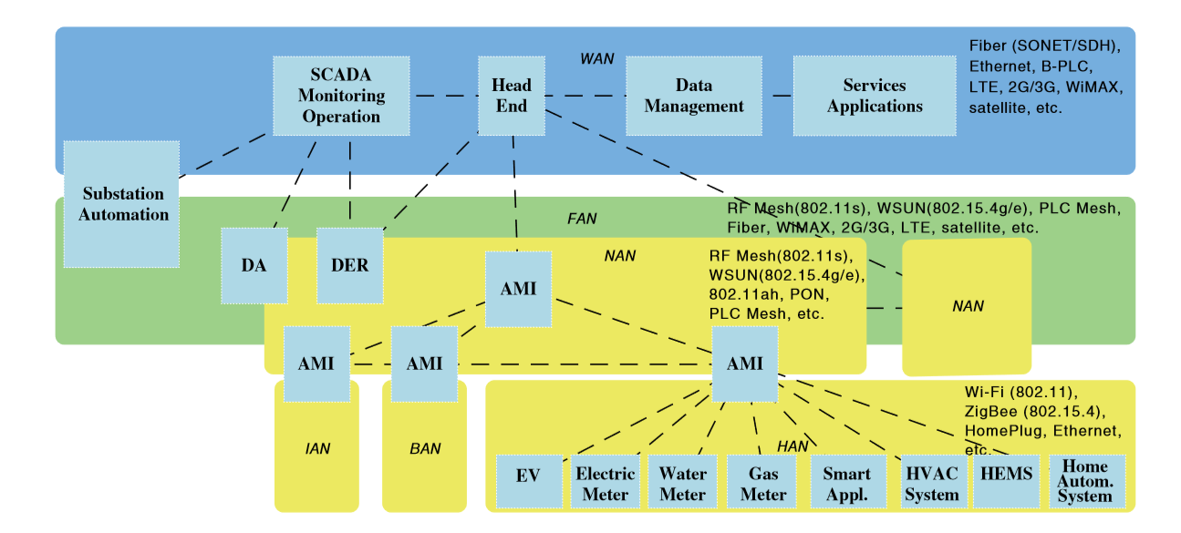
Three Layer Communication System
Wide Area Network
Field Area Network
Home Area Network

Slide 4
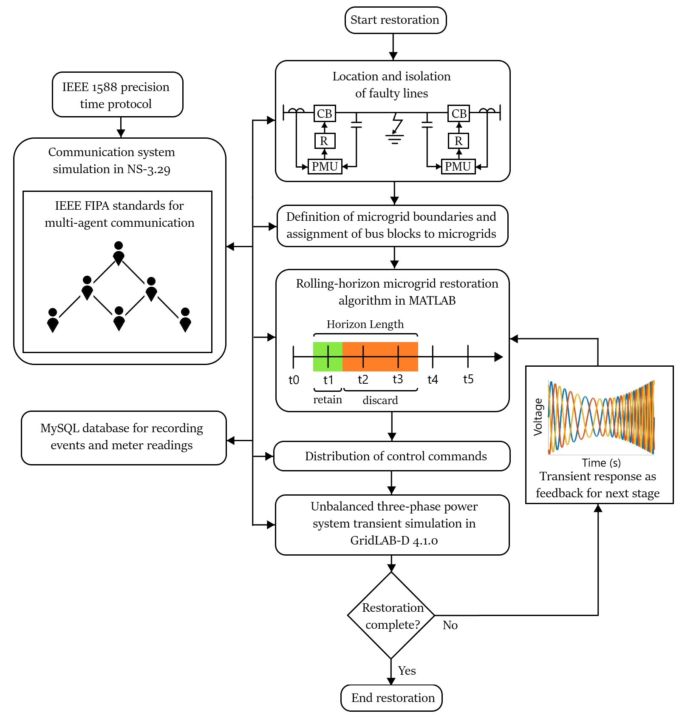
Three Level Microgrid Restoration Procedure
Fault location and isolation
Formation of teams
Service restoration

Slide 5
Optimization Algorithm

Slide 6
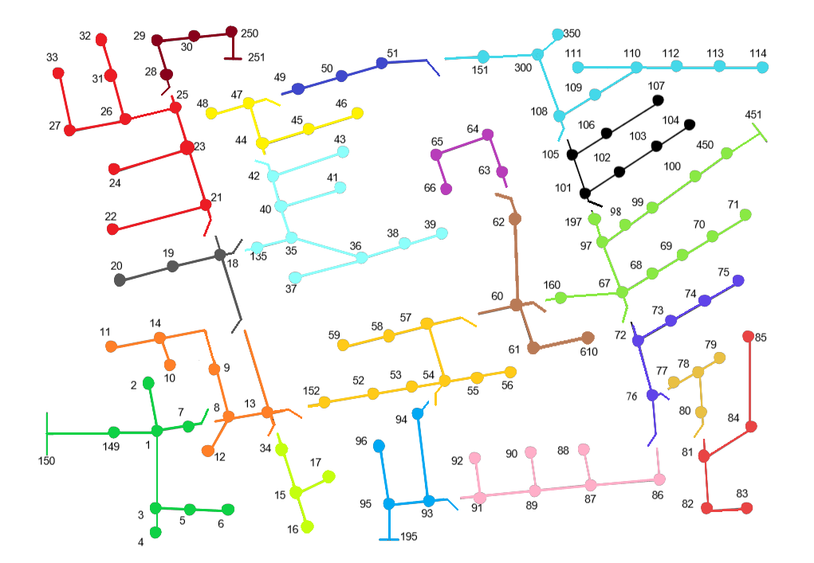
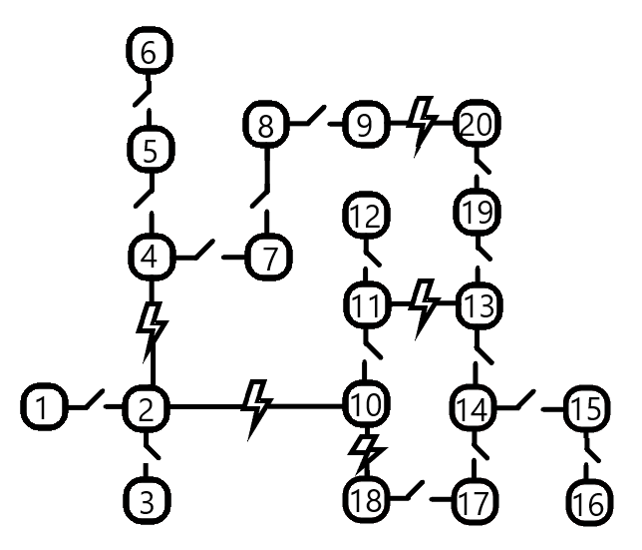
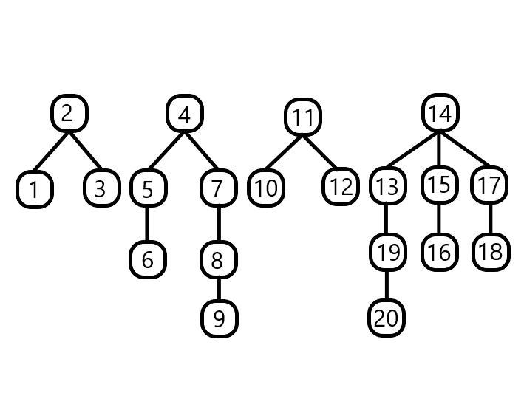
Microgrid Formation Using Recursive Depth First Search
2. Generate reduced graph,
find microgrid boundaries and
assign central nodes for each microgrid
3. Use recursive depth first search
to traverse each microgrid and
assign energization ranking
for all bus blocks
1. Open all switchable lines and find all
possible islanded bus blocks

Slide 7
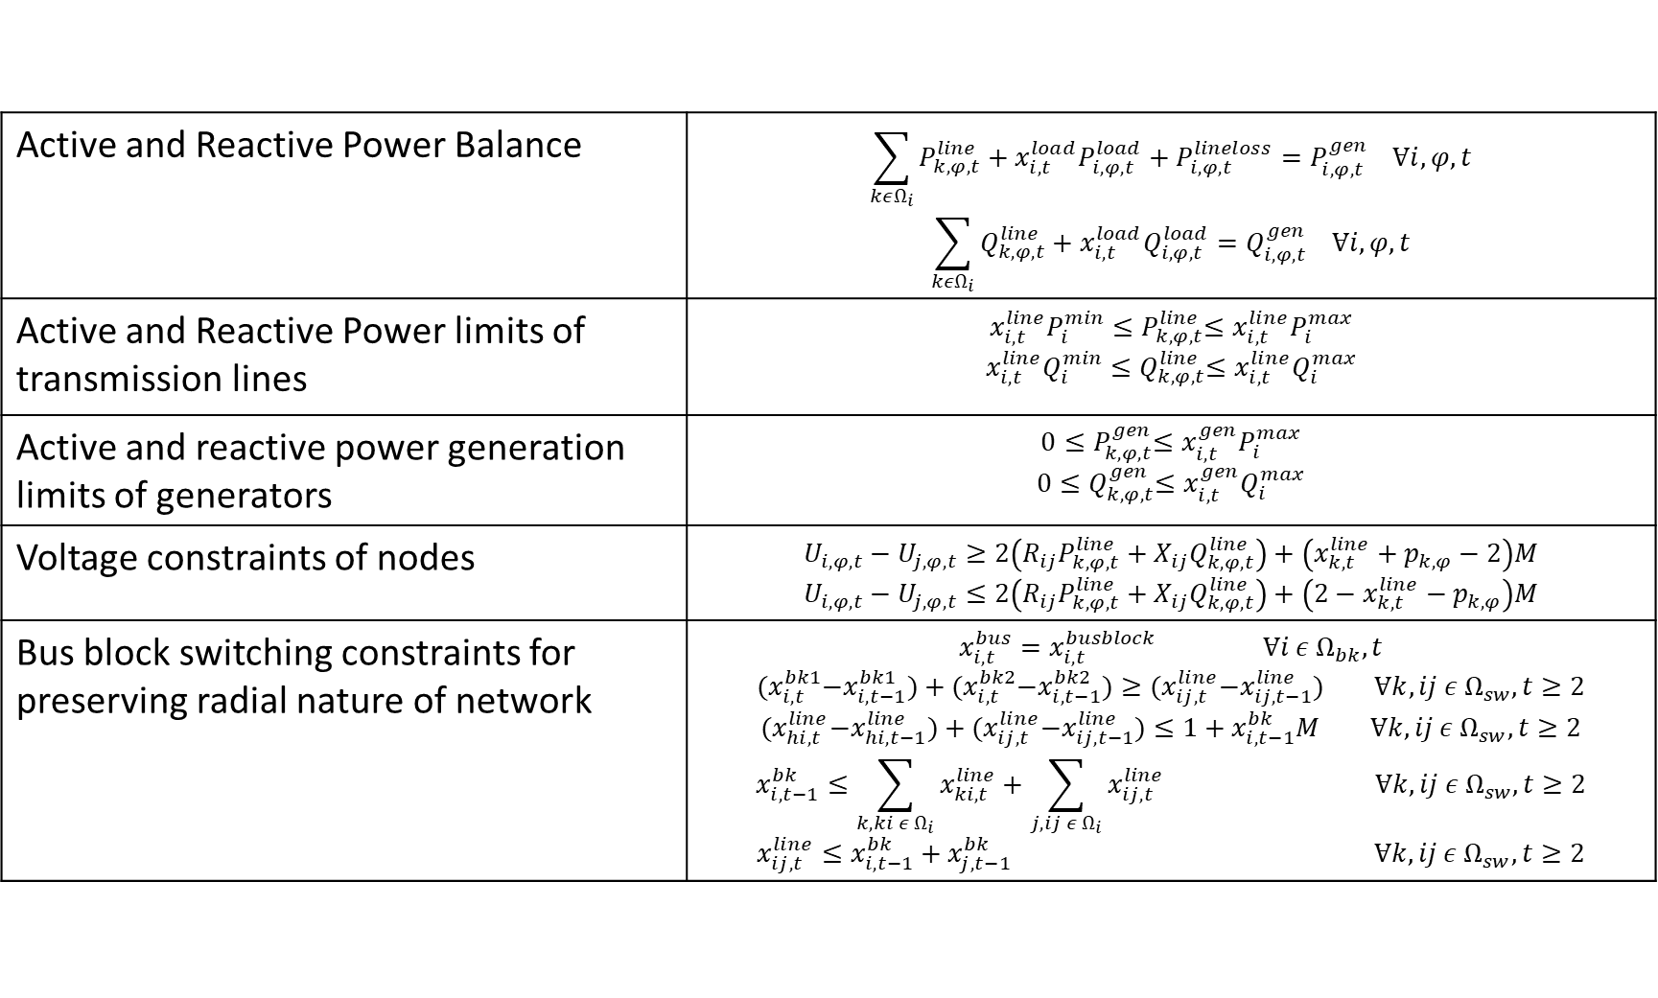
Self Healing Optimization Problem
Active and Reactive Power Balance | $$\sum_{kεΩ_{i}}{P_{k,φ,t}^{line}}+x_{i,t}^{load}P_{i,φ,t}^{load}+P_{i,φ,t}^{lineloss}=P_{i,φ,t}^{gen} Ɐi,φ,t$$ $$\sum_{kεΩ_{i}}{Q_{k,φ,t}^{line}}+x_{i,t}^{load}Q_{i,φ,t}^{load}=Q_{i,φ,t}^{gen} Ɐi,φ,t$$
Active and Reactive Power limits of transmission lines | $$x_{i,t}^{line}P_{i}^{min}{≤P}_{k,φ,t}^{line}≤x_{i,t}^{line}P_{i}^{max}$$ $$x_{i,t}^{line}Q_{i}^{min}{≤Q}_{k,φ,t}^{line}≤x_{i,t}^{line}Q_{i}^{max}$$
Active and reactive power generation limits of generators | $$0{≤P}_{k,φ,t}^{gen}≤x_{i,t}^{gen}P_{i}^{max}$$ $$0{≤Q}_{k,φ,t}^{gen}≤x_{i,t}^{gen}Q_{i}^{max}$$
Voltage constraints of nodes | $$U_{i,φ,t}−U_{j,φ,t}≥2\left(R_{ij}P_{k,φ,t}^{line}+X_{ij}Q_{k,φ,t}^{line}\right)+\left(x_{k,t}^{line}+p_{k,φ}−2\right)M$$ $$U_{i,φ,t}−U_{j,φ,t}≤2\left(R_{ij}P_{k,φ,t}^{line}+X_{ij}Q_{k,φ,t}^{line}\right)+\left(2−x_{k,t}^{line}−p_{k,φ}\right)M$$
Bus block switching constraints for preserving radial nature of network | $$x_{i,t}^{bus}=x_{i,t}^{busblock} Ɐi ε Ω_{bk},t$$ $${(x}_{i,t}^{bk1}−x_{i,t−1}^{bk1})+{(x}_{i,t}^{bk2}−x_{i,t−1}^{bk2})≥{(x}_{ij,t}^{line}−x_{ij,t−1}^{line}) Ɐk,ij ε Ω_{sw},t≥2$$ $${(x}_{hi,t}^{line}−x_{hi,t−1}^{line})+{(x}_{ij,t}^{line}−x_{ij,t−1}^{line})≤1+x_{i,t−1}^{bk}M Ɐk,ij ε Ω_{sw},t≥2$$ $$x_{i,t−1}^{bk}≤\sum_{k,ki ε Ω_{i}}{x_{ki,t}^{line}}+\sum_{j,ij ε Ω_{i}}{x_{ij,t}^{line}} Ɐk,ij ε Ω_{sw},t≥2$$ $$x_{ij,t}^{line}≤x_{i,t−1}^{bk}+x_{j,t−1}^{bk} Ɐk,ij ε Ω_{sw},t≥2$$

Slide 8
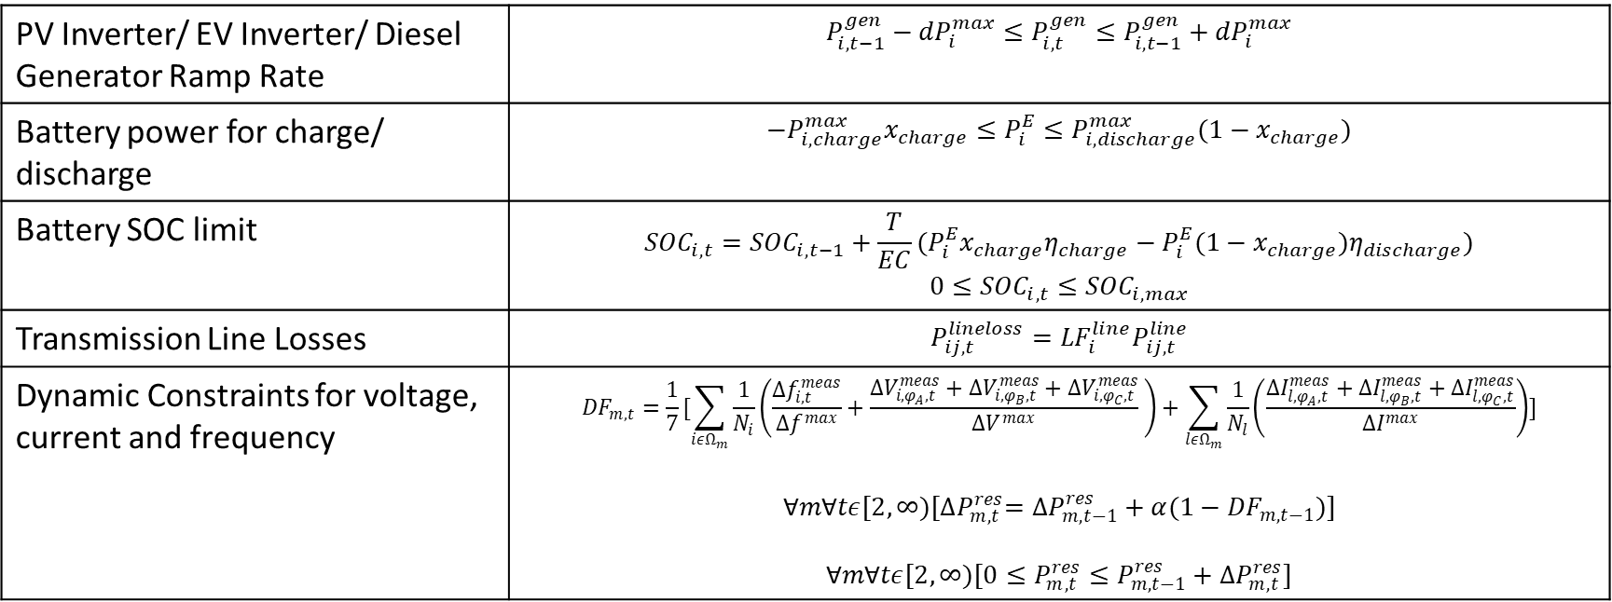
Self Healing Optimization Problem
PV Inverter/ EV Inverter/ Diesel Generator Ramp Rate | $$P_{i,t−1}^{gen}−{dP}_{i}^{max}≤P_{i,t}^{gen}≤P_{i,t−1}^{gen}+{dP}_{i}^{max}$$
Battery power for charge/ discharge | $$−P_{i,charge}^{max}x_{charge}≤P_{i}^{E}≤P_{i,discharge}^{max}(1−x_{charge})$$
Battery SOC limit | $${SOC}_{i,t}={SOC}_{i,t−1}+\frac{T}{EC}(P_{i}^{E}x_{charge}η_{charge}−P_{i}^{E}(1−x_{charge})η_{discharge})$$ $$0≤{SOC}_{i,t}≤{SOC}_{i,max}$$
Transmission Line Losses | $$P_{ij,t}^{lineloss}={LF}_{i}^{line}P_{ij,t}^{line}$$
Dynamic Constraints for voltage, current and frequency | $${DF}_{m,t}=\frac{1}{7}[\sum_{iεΩ_{m}}{\frac{1}{N_{i}}\left(\frac{∆f_{i,t}^{meas}}{∆f^{max}}+\frac{∆V_{i,φ_{A},t}^{meas}+∆V_{i,φ_{B},t}^{meas}+∆V_{i,φ_{C},t}^{meas}}{∆V^{max}} \right)}+\sum_{lεΩ_{m}}{\frac{1}{N_{l}}\left(\frac{∆I_{l,φ_{A},t}^{meas}+∆I_{l,φ_{B},t}^{meas}+∆I_{l,φ_{C},t}^{meas}}{∆I^{max}}\right)]}$$ $ⱯmⱯtε[2,∞)[{∆P}_{m,t}^{res}={∆P}_{m,t−1}^{res}+α{(1−DF}_{m,t−1})]$ $$ⱯmⱯtε[2,∞)[0≤P_{m,t}^{res}≤P_{m,t−1}^{res}+{∆P}_{m,t}^{res}]$$

Slide 9
Communication Network

Slide 10
Three Layer Communication System
Wide Area Network
Field Area Network
Home Area Network

Slide 11
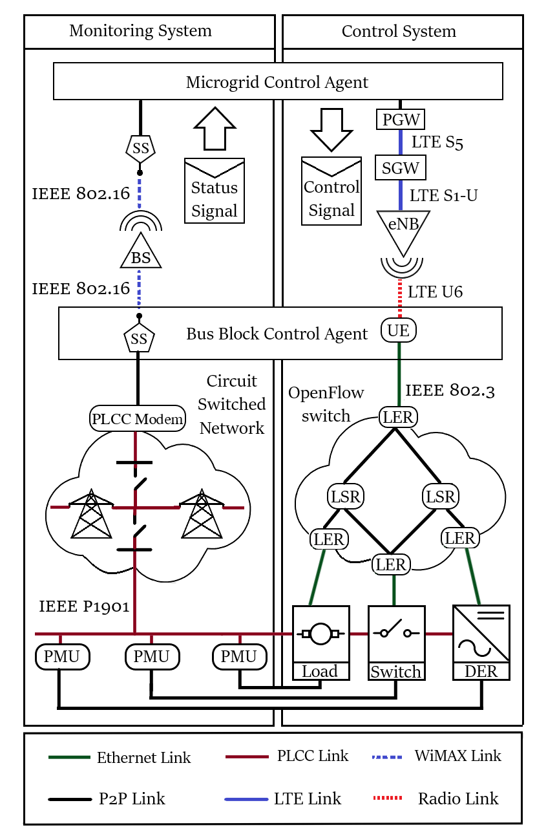
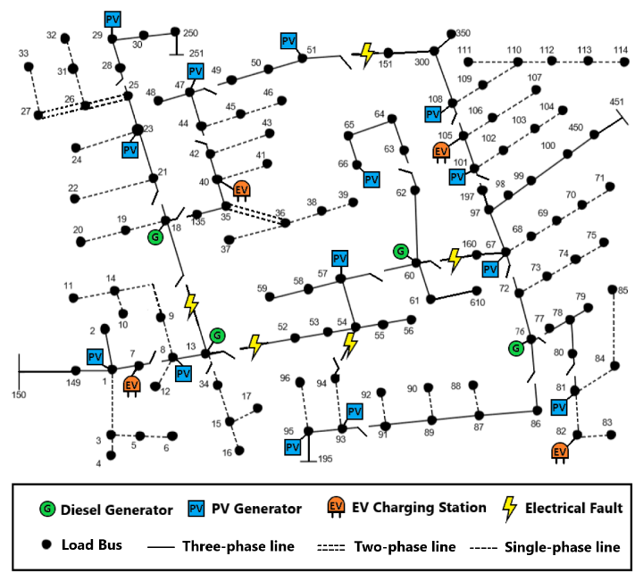
Control and monitoring system

Slide 12
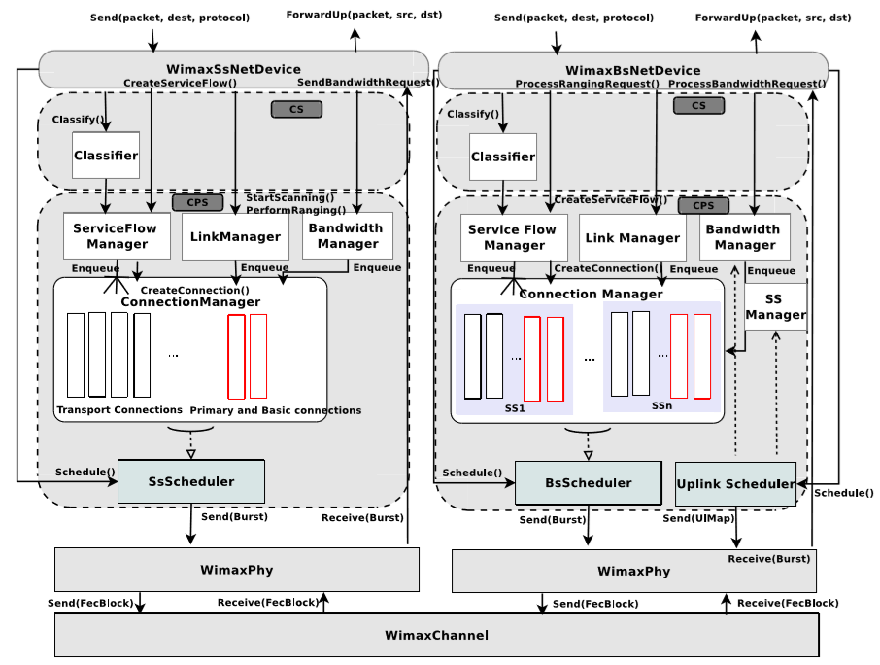
Wide Area Network: Wimax Architecture
Two basic modes of operation: Subscriber Station or Base Station.
A scalable and realistic physical layer.
WirelessMAN-OFDM channel model.
A packet classiﬁer for the IP convergence sublayer.
Efﬁcient uplink and downlink schedulers (priority based FCFS, polling service scheduler, migration-based uplink scheduler).
Support for Multicast and Broadcast Service (MBS).
Leverages wireless propagation loss and delay models.
Point-to-Multipoint mode.
IEEE-802.16 Service Flow Initialization.
Management Connection.
UGS, rtPS, nrtPS, and BE connections.

Slide 13
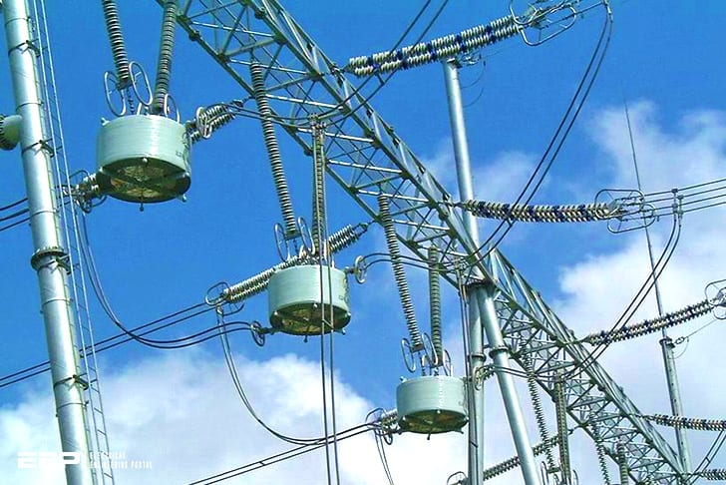
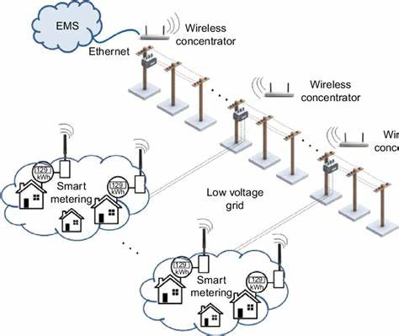
Field Area Network: PLC Communication
Power line communications are an attractive technology to transport the smart meter aggregated information acquired by home area networks, without the elevated cost and implantation time required by the well-known solutions based on wireless and optical fibers.
PLC network connects DG substations, load centers and circuit breakers

Slide 14
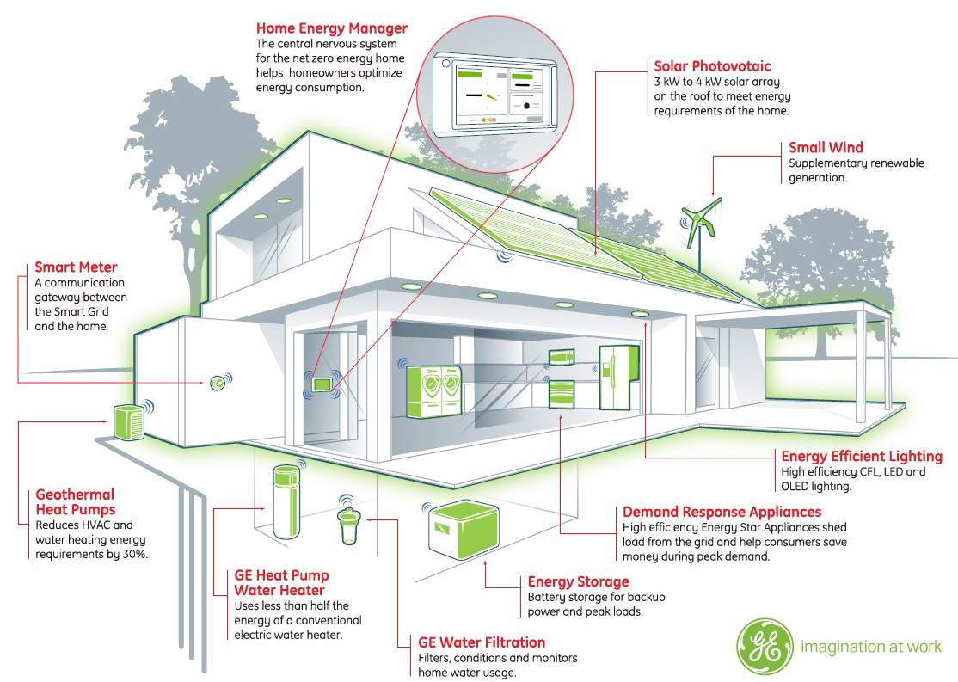
Home Area Network: Ethernet
The Ethernet connects
Smart meters and PMUs
Diesel generator controller
Load controllers
PV inverter controller
Energy storage controller
Auxiliary Relays and switches

Slide 15
Multi-agent System for FLISR

Slide 16
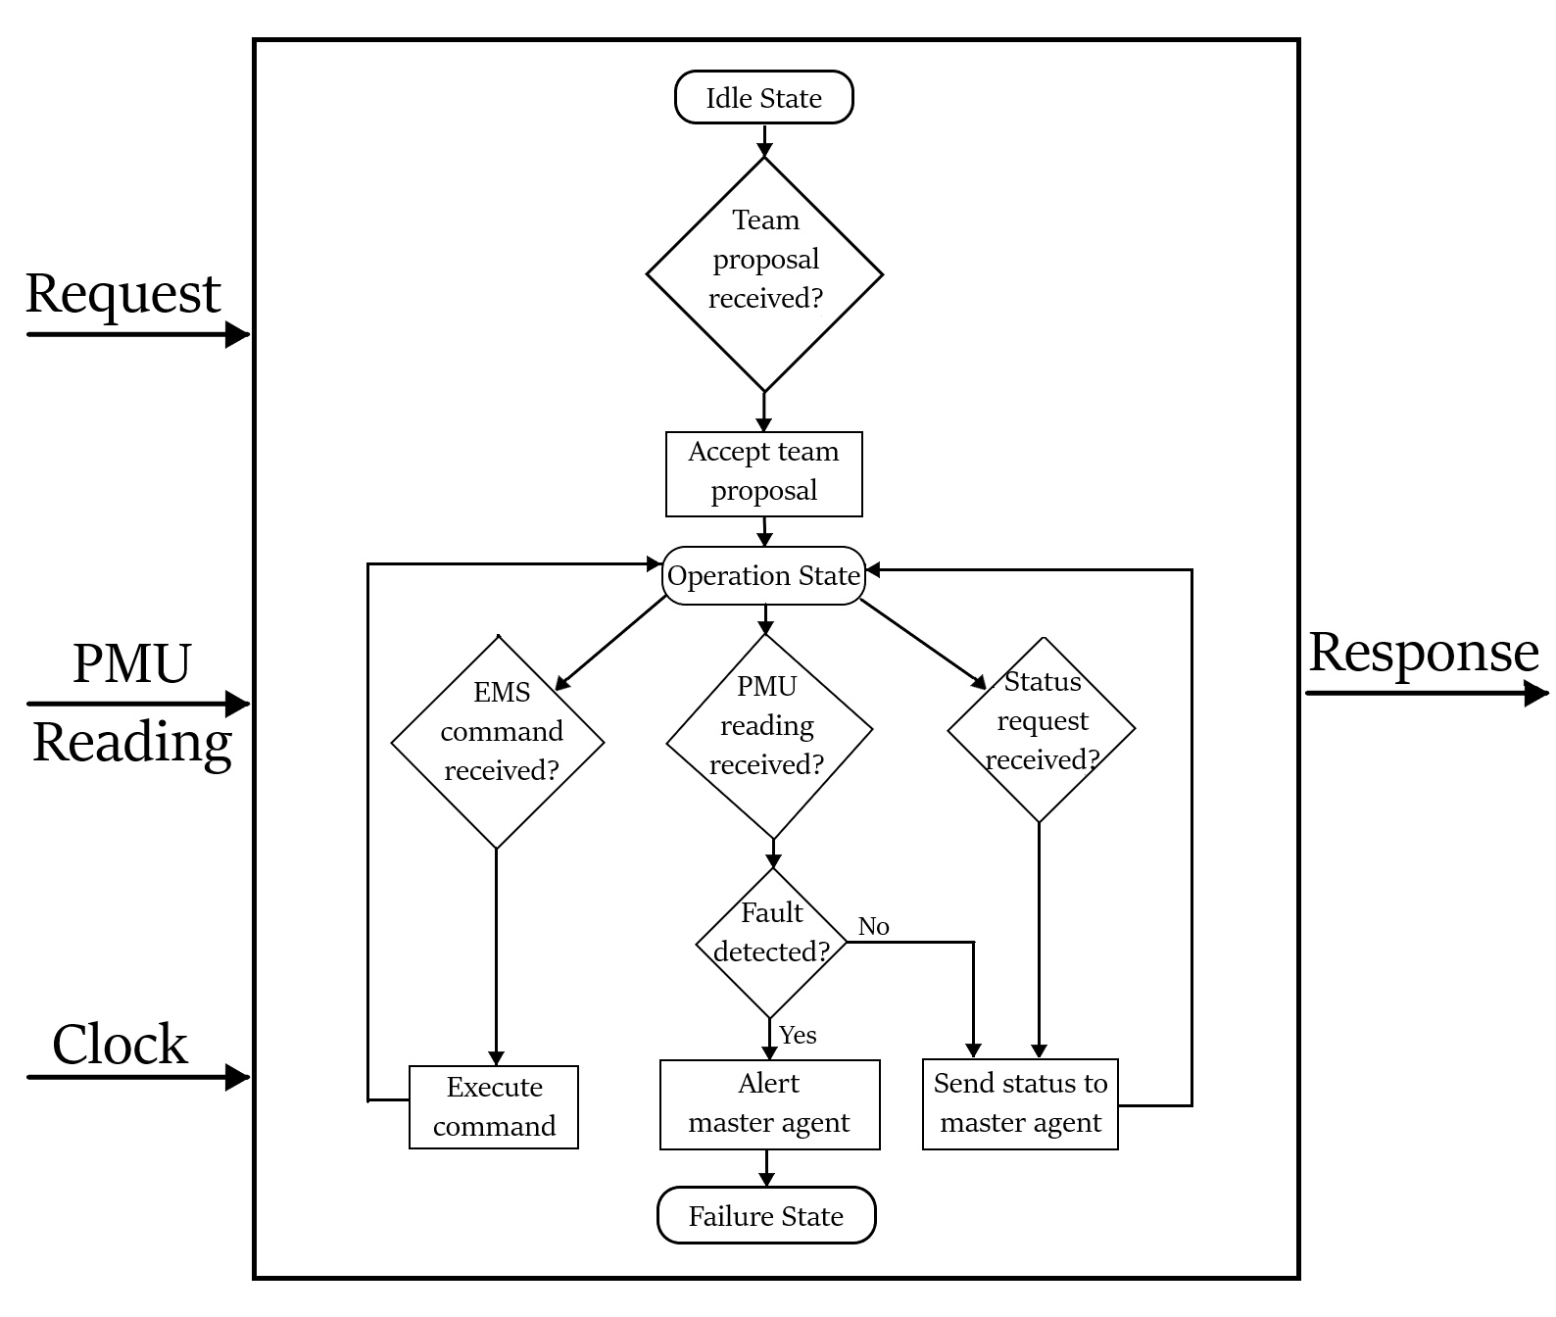
Java Agent Development Environment
Reactivity
Pro-activeness
Social ability

Slide 17
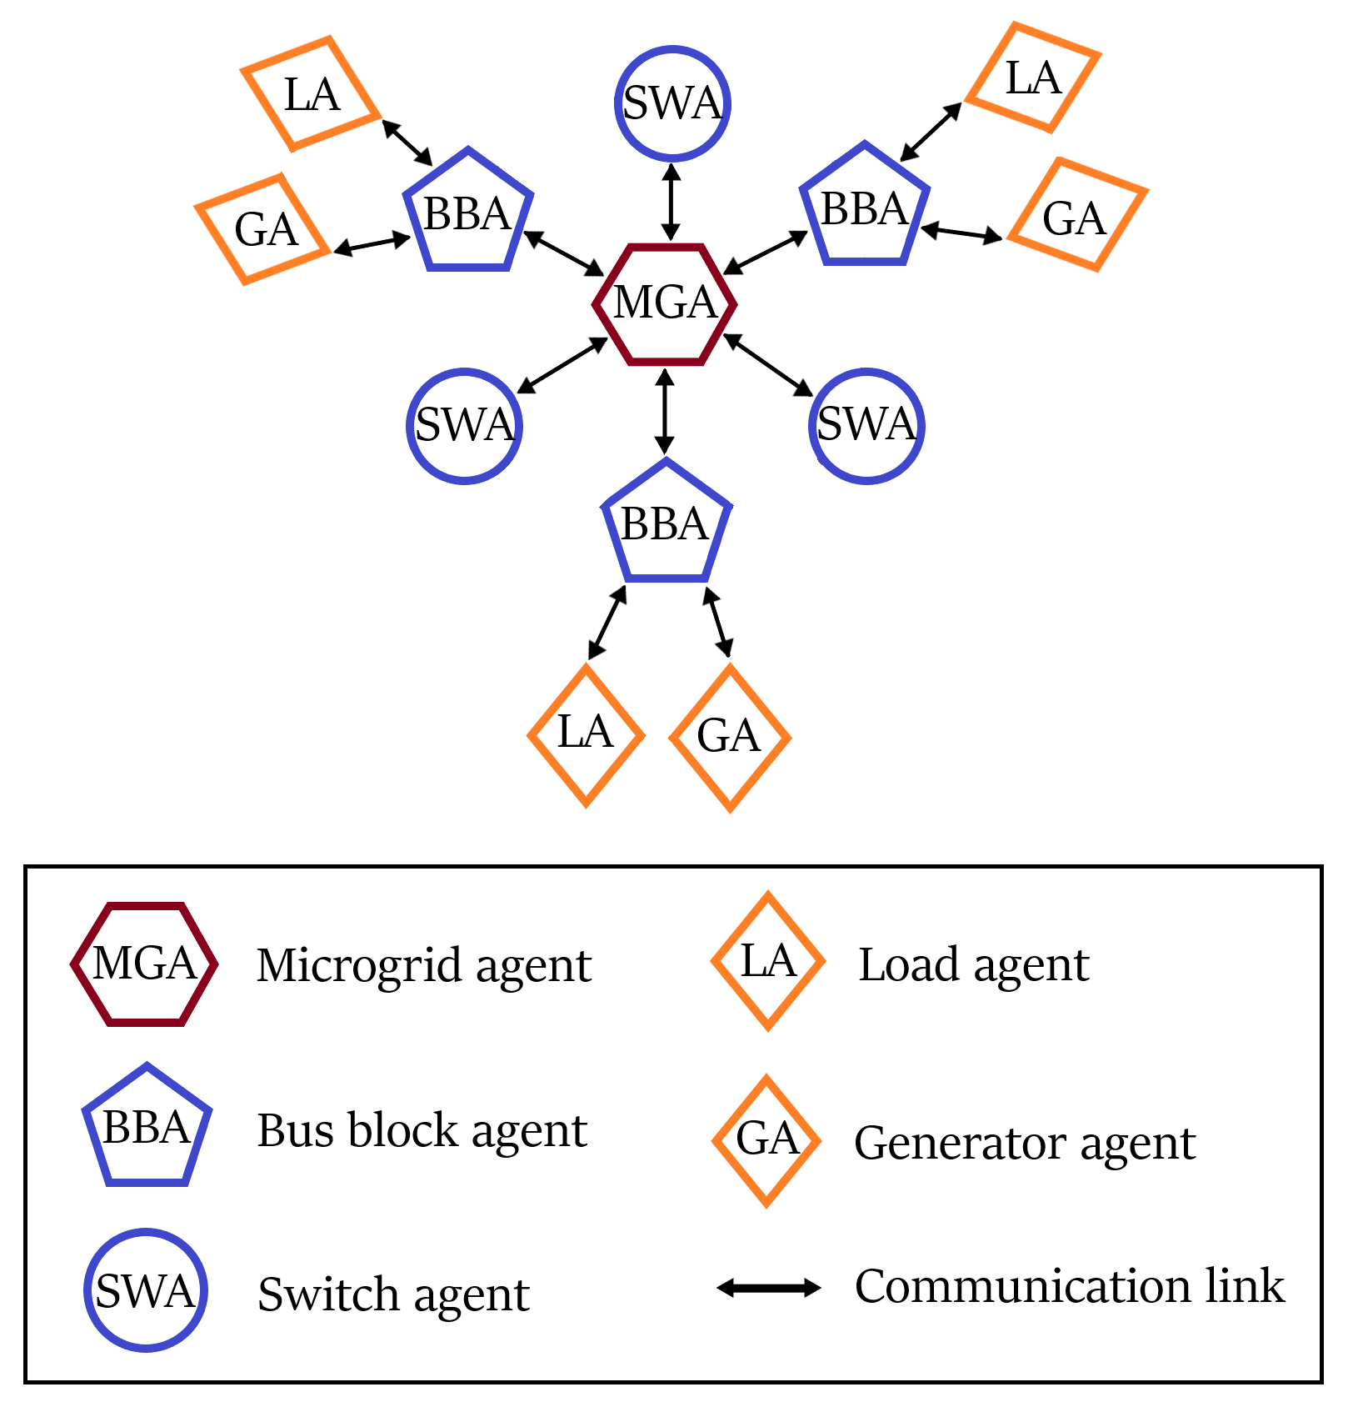
Multi-agent System

Slide 18
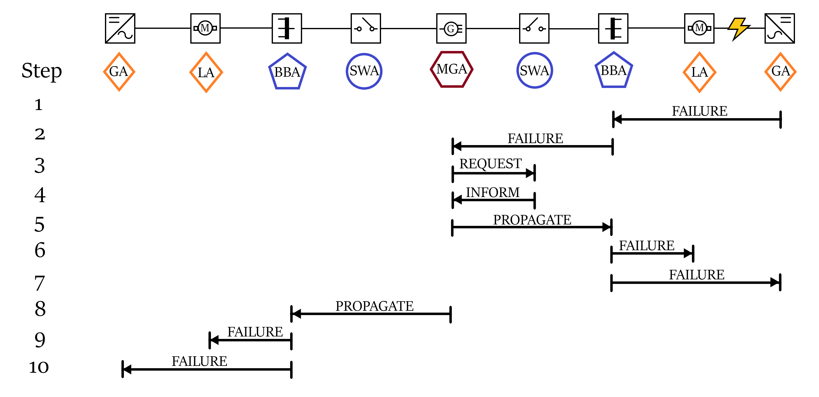
Fault location and isolation

Slide 19
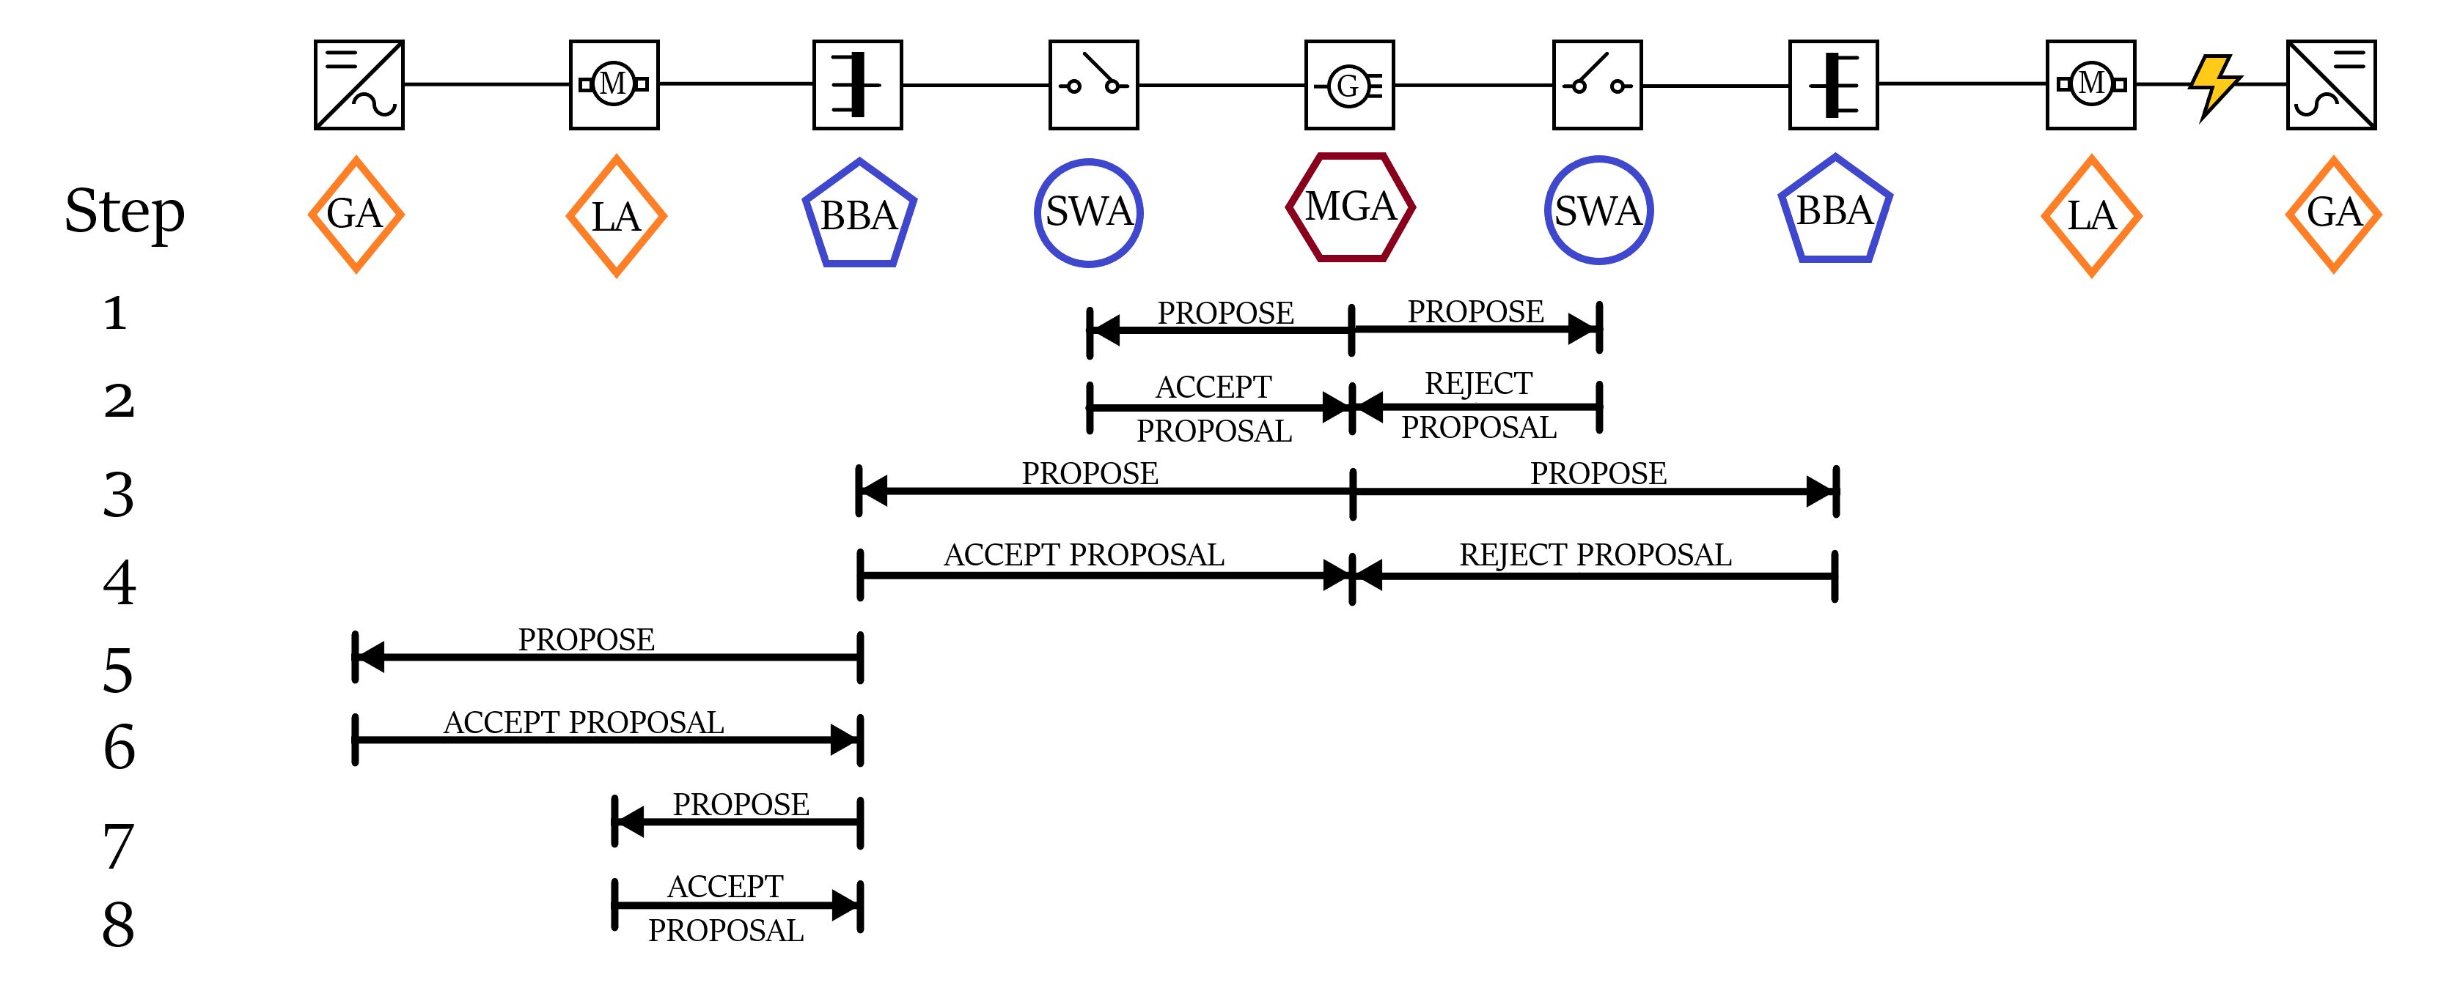
Formation of teams

Slide 20
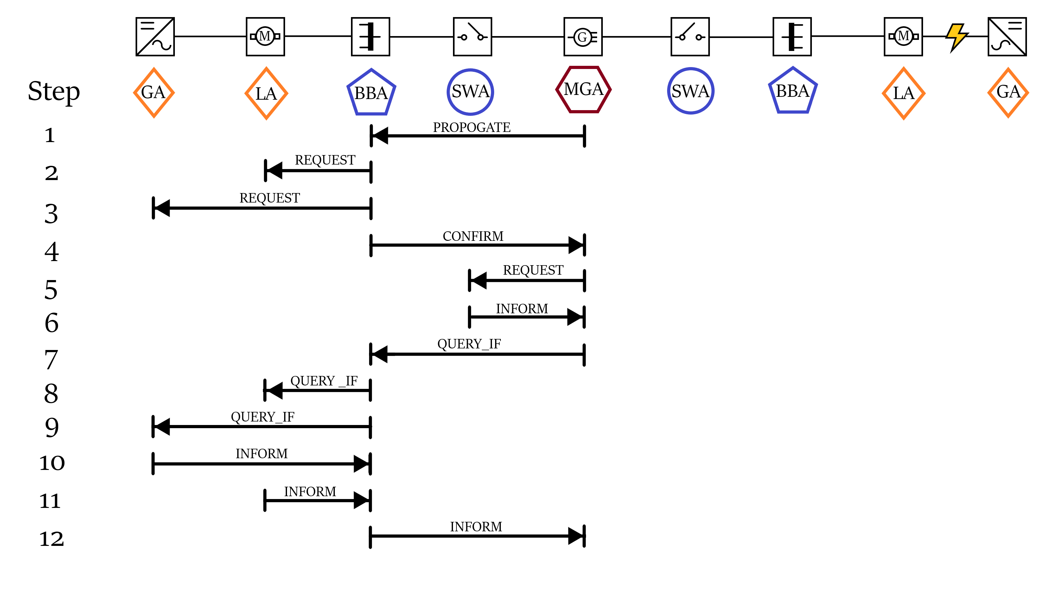
Control and monitoring

Slide 21
Power System Simulation

Slide 22
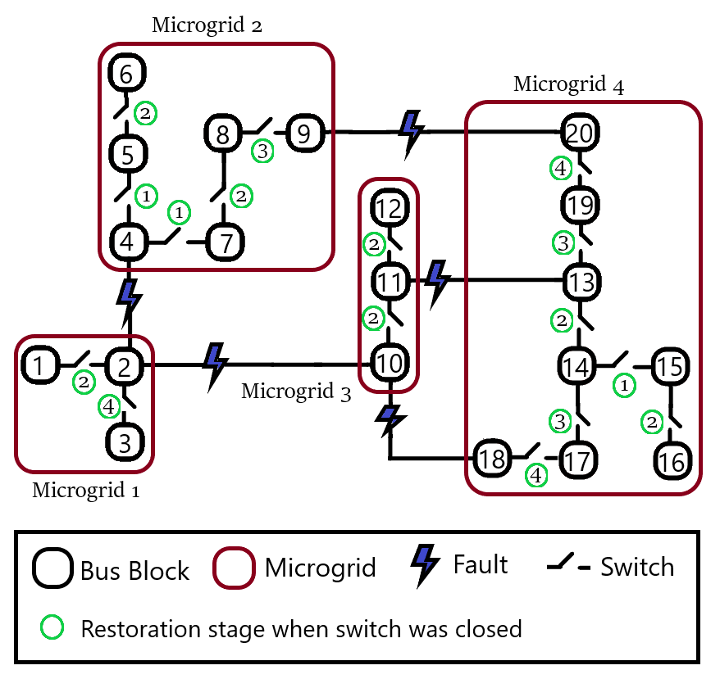

Slide 23
